Slide 1
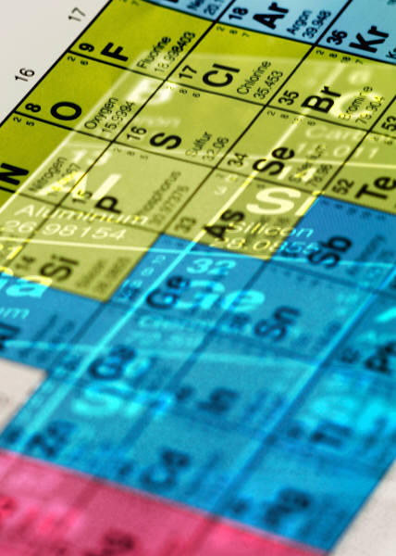
Periodic Classification of Elements
-Rishi

Slide 2
Introduction:
There are 114 elements known at present and it is very difficult to study the properties of all these elements separately.
Around the year 1800, only 30 elements were known.
Scientists started looking for some pattern in their properties on the basis of which they could study the elements with ease.
Therefore, the elements have been classified into groups based on similarities in their properties.

Slide 3
Early Attempts at the Classification of Elements:
The earliest attempt to classify the elements resulted in grouping the elements as metals and non-metals.
Later further classifications were tried out as the knowledge of elements and their properties increased.

Slide 4
Johann Wolfgang Dobereiner:
In the year 1817, a German chemist, Johann Wolfgang Dobereiner, observed that certain elements had similar properties and that he could put them together, in groups of 3 elements each.
These groups were called ‘triads’.
Dobereiner’s Law of Triads:
‘When the three elements in a triad are written in the order of increasing atomic masses, the atomic mass of the middle element was roughly the average of the atomic masses of the other two elements’.

Slide 5
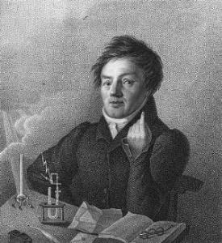
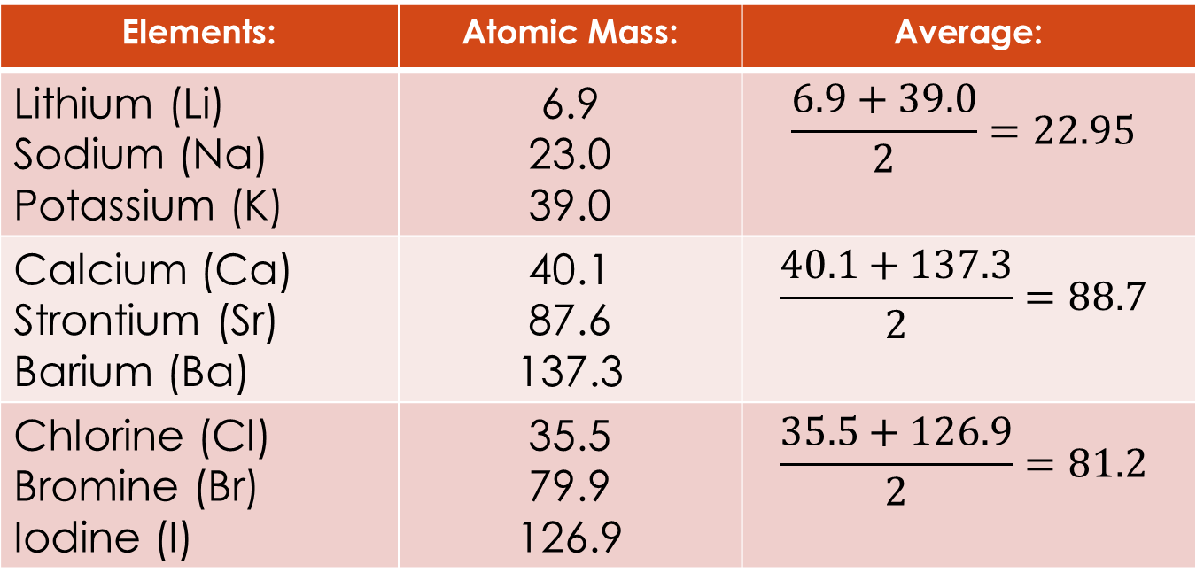
Dobereiner’s Triads:
Elements: | Atomic Mass: | Average:
Lithium (Li) Sodium (Na) Potassium (K) | 6.9 23.0 39.0 | $$\frac{6.9+39.0}{2}=22.95$$
Calcium (Ca) Strontium (Sr) Barium (Ba) | 40.1 87.6 137.3 | $$\frac{40.1+137.3}{2}=88.7$$
Chlorine (Cl) Bromine (Br) Iodine (I) | 35.5 79.9 126.9 | $$\frac{35.5+126.9}{2}=81.2$$

Slide 6
Limitations of Dobereiner’s Classification:
It failed to arrange all the known elements in the form of triads of elements having similar chemical properties.
Dobereiner could identify only 3 triads from the elements known at that time. Hence, this system of classification was not found to be useful.

Slide 7
John Newland:
In 1866, John Newlands, an English scientist, arranged the then known elements in the order of increasing atomic masses.
He started with Hydrogen and ended at Thorium.
He found that every eighth element had similar properties of the first, just like the notes of music (octaves).
Newland’s Law of Octaves:
‘When elements are arranged in the order of increasing atomic masses, the properties of every eighth element were similar to that of the first.’

Slide 8
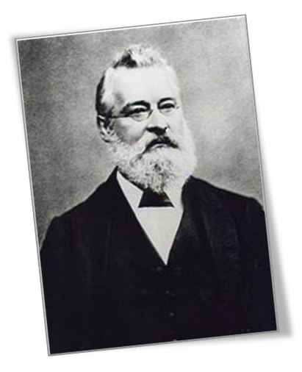
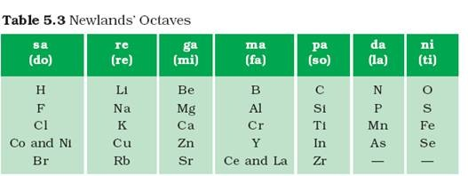
Newland’s Octaves:

Slide 9
Limitation of Newland’s law:
It was applicable only till Calcium, i.e. after Calcium, every 8th element didn’t posses the same properties of the 1st element.
Newland assumed that only 56 elements existed. But later other elements came to place and didn’t fit into his law.
In order to fit elements into his table, he fit elements like Co and Ni under the same slot and that too in the same column as F, Cl and Br which have very different properties than these elements.
Fe, which resembles Co and Ni in properties was kept far away from these elements.

Slide 10
Dmitri Ivanovich Mendeleev:
In 1869, Mendeleev, a Russian scientist arranged the then known 63 elements on the basis of similarities in properties. Among similarities, he concentrated on the compounds formed with oxygen and hydrogen.
He arrange the elements on the similarities in formula of compound (oxides and hydrides) formed by these elements.
His observations:
Most of the elements that got a place in his periodic table were arranged in the order of increasing atomic masses.
There occurs a periodic reoccurrence of elements with similar physical and chemical properties.

Slide 11
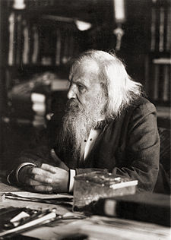
Mendeleev’s Periodic Law:
Mendeleev formulated a
Periodic Law that stated that:
‘The properties of elements are the
periodic function of their atomic
masses.’
Mendeleev’s Periodic Table contains vertical columns called ‘groups’ and horizontal rows called ‘periods’.

Slide 12
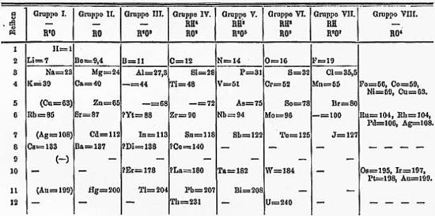
Mendeleev’s Periodic Table:

Slide 13
Achievements of Mendeleev’s Periodic Table: (1)
There were some cases where elements slightly having higher atomic masses were placed before the elements having slightly lower atomic masses. But, the sequence could be inverted so that the elements with similar properties could be grouped together. Eg: Co(58.9) appeared before Ni(58.7).
Mendeleev left some gaps for elements which were yet to be discovered at that time.

Slide 14
Achievements of Mendeleev’s Periodic Table: (2)
He named them by prefixing a Sanskrit numeral Eka (one) to the name of the preceding element in the same group. Eg: Sc, Ga, Ge, discovered later, had properties similar to Eka-Boron, Eka-Aluminum and Eka-Silicon.
Noble gases like Helium, Neon and Argon were discovered very late because they are very inert and present in extremely low concentrations in our atmosphere. When these gases were discovered, they, could be placed in a new group without disturbing the existing order.

Slide 15
Limitations of Mendeleev’s Classification: (1)
Mendeleev couldn’t assign a correct position to Hydrogen. He placed Hydrogen with alkali metals and again with halogens. Like alkali metals, H combines with halogens, oxygen and sulphur to form compounds. Also, like halogens, it also exists as diatomic molecules and it combines with metals and non-metals to form covalent compounds.
Isotopes of an element have similar chemical properties but different atomic masses. So according to increasing order of atomic masses, they should be placed in different groups but as they show similar properties, they should be placed in the same group. Hence, position of isotopes was not certain.

Slide 16
Limitations of Mendeleev’s Classification: (2)
Wrong order of atomic masses of few elements: Mendeleev arranged the elements in order of increasing atomic masses, but at a number of places in his table, this order wasn’t followed.
Eg: Al(29.98) was placed before Si(28.09).
Irregular increase in atomic masses: In his table, atomic masses did not increase in a regular manner in going from one element to the next. So it was not possible to predict how many elements discovered between 2 elements.

Slide 17
Try this:
Using Mendeleev’s Periodic Table, predict the formulae for the oxides of the following elements:
K
C
Al
Si
Ba

Slide 18
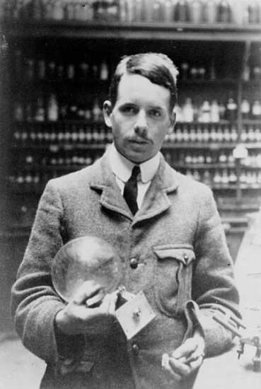
The Modern periodic table:
In 1913, Henry Mosely showed that the atomic number of an element is a more fundamental property than it’s atomic mass.
Mendeleev’s Periodic Table was modified and
atomic number was adopted as the basic of
Modern periodic table.
Modern Periodic Table law states that:
‘Properties of elements are a periodic function
of their atomic number’
The prediction of properties of elements could be
made with more precision when elements were arranged on the basis of increasing atomic number.
The Modern Periodic Table helps overcome the 3 limitations of Mendeleev’s Periodic Table.

Slide 19
Position of elements in the Modern Periodic Table:
The Modern Periodic Table has 18 vertical columns known as ‘groups’ and 7 horizontal rows known as ‘periods’.
The arrangement is based on their electronic configuration.
There is an irregularity when it comes to the position of H. It can either be placed in group 1 since the electronic config. of H is similar to alkali, or it can be placed in group 7 with halogens because it forms diatomic molecules.
The atoms of different elements with the same number of occupied shells are placed in the same period.
The position of an element in the periodic table tells us about it’s chemical reactivity.
The valence electrons determine the kind and number of bonds formed by an element.

Slide 20
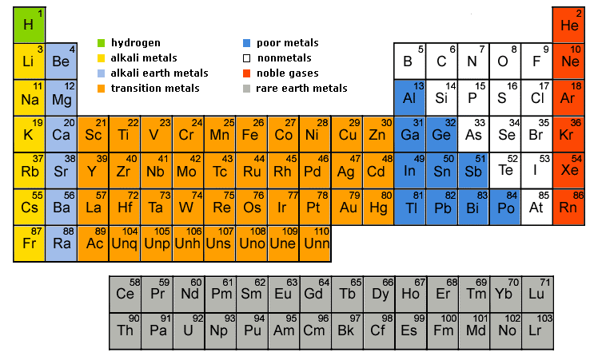
The Modern Periodic Table:

Slide 21
Trends in the modern periodic table:
Valency: It is determined by the number of valence electrons present in the outer shell if its atom.
Variation of valency in a period: On moving from left to right in each short period, the valency of elements increases from 1-4 and decreases to 0.
Variation of valency in a group: Since the number of valence electrons of all elements in a groups is same, all elements in a group have same valency.
Atomic Size: It refers to the radius of an atom.
Variation in a period: On moving left to right, the size of atoms decrease.
Variation in a group: On going down, the size of atoms increase.

Slide 22
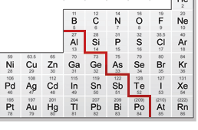
Metallic & Non-metallic properties:
In the Modern Periodic table, a zigzag line separates metals from non-metals.
Metalloids: The border-line elements like
B, Si, Ge, As, Sb, Te and Po exhibit
properties of both metals and non-metals.
Metals: They are found on the left side of
the periodic table.
Variation in a period: On moving left to right, the metallic character of elements decrease.
Variation in a group: On moving down, the metallic character of elements increases

Slide 23
Contd.
Non-metals: They are found on the right side of the periodic table.
Variation in a period: On moving left to right, the non-metallic character increases.
Variation in a group: On moving down, the non-metallic character of elements decreases.
Oxides: Oxides of metals are basic and of non-metals are acidic in general.
Variation in a period: On moving from left to right, the basic nature of oxides decreases, the acidic nature of oxides decreases.
Variation in a group: On moving down, the basic nature of oxides increases, the acidic nature of oxides decreases.

Slide 24
THE END
Thank You ☺

